Slide 1
Are your asset adequacy testing interest rate scenarios up to date?
A Discussion of modern deterministic scenarios for interest rates
Presented by

Slide 2
Disclaimer
This presentation and discussion are not sponsored nor endorsed by the Society of Actuaries (SOA) or the original author of the report, Mark Alberts. It was developed to provide a general overview of the issues related to its subject matter. The comments and recommendations in this presentation and subsequent discussion are not intended to provide specific consulting advice or a statement of actuarial opinion. The unique situation of an individual company should always be considered in determining an appropriate response.

Slide 3
Agenda
Background
Data
Analytics
Scenarios
Scenario comparisons at 12/31/2020
Observations
Future improvements
Discussion

Slide 4
“Rather than trying to reinvent the wheel, build on to that which is already excellent.”
Oscar Auliq-ice

Slide 5
Background
Appointed Actuary opines that reserves are adequate under moderately adverse conditions
No basis for definition of moderately adverse conditions
In most states, interest rate scenarios not defined by regulation for asset adequacy analysis
Appointed Actuary required to decide interest rate scenarios to test
One of the more common interest rate scenario sets - New York 7 (NY7)

Slide 6
New York 7 Interest rate scenarios
NY1 “Level” – interest rates remain level throughout projection
NY2 “Increasing” – uniformly increase .5% per year for 10 years, level
NY3 “Mountain” – uniformly increase 1% per year for 5 years, uniformly decrease 1% per year for 5 years, level
NY4 “Pop-up” – immediate increase of 3%, level
NY5 “Decreasing” – uniformly decrease .5% per year for 10 years, level
NY6 “Valley” – uniformly decrease 1% per year for 5 years, uniformly increase 1% per year for 5 years, level
NY7 “Pop-down” – immediate decrease of 3%, level
For year end 2020 testing, NY introduced the following additional modifications to NY1-NY4
Grade 10-year treasury linearly to 1.50% at end of projection year 10
Apply parallel shift to other points on treasury curve consistent with 10-year modification
If starting 10-year treasury exceeds 1.50%, no modified scenarios required

Slide 7
Emerging practice
Progression toward formal definition of moderately adverse
CTE70 has gained acceptance as measure of moderately adverse
CTE70 formally adopted by NAIC for VA reserving in Actuarial Guideline 43
CTE70 incorporated in VM-20 and VM-21 as part of requirements for principle- based reserves
CTE applied for evaluating stochastically generated scenarios but can also be useful for deterministic scenario evaluation

Slide 8
Data sources
Interest rates, common stock returns, corporate bond data, and inflation
Numerous sources considered utilizing the following criteria:
publicly available
clear documentation of original source
internal consistency
broad applicability of underlying data
appropriateness to objectives of MDS
No predefined time period, long a period as relevant data available
Considered factors that could limit applicability of historical data
Industrial Revolution (circa 1760) – prior data less applicable for economic growth rates
default risk on government bonds – data prior to 1600s less applicable
world center of financial power – U.K. prior to 1920, U.S. thereafter

Slide 9
Data Limitations
No single data set existed
Instrument changes over times
Limitations led to the following:
Utilization of several data sources to construct MDS Interest Rate Series that includes MDS Short Rate Series and MDS Long Rate Series
entire yield curve for scenario projections constructed from the MDS Interest Rate Series
MDS Interest Rate Series based on yearly average interest rate data
prior to 1920, U.K. not U.S. data would be primary basis of MDS Interest Rate Series

Slide 10
Mds long interest rate series
Consists of 287 yearly observations
Sources and time periods:
1953-2015 simple average of 20-year and 30-year CMT from Federal Reserve Board
1942-1952 yield on fully taxable U.S. Government bonds due or callable after 15 years
1923-1941 Moody’s AAA Corporate Bond Yield less 31 bps credit spread
1922 average of rates from sources for 1729-1921 and 1923-1941
1729-1921 Yield on Bank of England Consolidated Annuities

Slide 11
Mds short interest rate series
Consists of 191 yearly observations
Sources and time periods:
1934-2015 3-month Treasury bill secondary market rate
1931-1933 3-month Treasury bill new issues’ rate
1918-1930 Prime bankers’ acceptances, 90 days
1913-1917 London market discount rate on bills of exchange with varying bps increases
1825-1912 London market discount rate on bills of exchange

Slide 12
MDS interest rate series observations
Long rates exhibited effective floor between 2 and 3%
Short rates approached 0% in only two periods – Great Depression of the 1930s and Great Recession beginning in 2008
Prior to 1970s, no precedent for Long Rates above 6% or Short Rates above 8%
1980s double-digit interest rates appear extreme in historical context
Minimal consistency in interest rate cycles to allow them to be useful for prediction
Short rates exhibit greater volatility than long rates in all observed time periods
Prior to 1920, no consistent term structure

Slide 13
Moderately adverse
Reasonable assumption that greatest losses will occur in scenarios where interest rates are either relatively high or low
Capturing both sides of CTE70 tail allows for wide range use since results will be company and product specific
CTE70 standard was modified to include 15% from left tail and 15% from right tail
CTE_{H}85 represents right tail (avg. of highest 15% of values for given interest rate)
CTE_{L}85 represents left tail (avg. of lowest 15% of values for given interest rate)

Slide 14
Analytical framework
Methodology termed Sample CTE analysis or Empirical CTE analysis
Approaches utilized in scenario development:
CTE Reversion Target Analysis – scenarios revert to a moderately adverse long term target independent of initial rate
Rate Change CTE Analysis – scenarios based on moderately adverse changes in interest rates where changes tied to initial rate level
Interest Rate Cycle Analysis – scenarios explicitly consider cyclical nature of interest rates and utilizes cyclical changes over the entire scenario horizon

Slide 15
Scenario shape considerations
Term structure does not incorporate parallel shifts
Do not include a level scenario
Reflect likely magnitude of upward and downward changes separately
Account for initial interest rates in setting scenario rates
Incorporated moderately adverse interest rate pops into Reversion and Rate Change CTE scenarios
Interest rate change periods longer than 10 years:
Reversion scenarios – 15 years
Rate Change CTE and AIRG scenarios – 30 years
Interest Rate Cycle scenarios – change for the entire duration

Slide 16
CTE Reversion target scenarios
8 scenarios:
MDS1 “Reversion: High” – grade linearly to CTE_{H}85 reversion target over 15 years
MDS2 “Reversion: Low” – grade linearly to CTE_{L}85 reversion target over 15 years
MDS3 “Delayed Reversion: High” – long and short rates level for 5 years, then grade linearly to CTE_{H}85 reversion target over 10 years
MDS4 “Delayed Reversion: Low” – long and short rates level for 5 years, then grade linearly to CTE_{L}85 reversion target over 10 years
MDS5 “Pop-up with Reversion: High” – initial pop up, then grade linearly to CTE_{H}85 reversion target by year 15
MDS6 “Pop-down with Reversion: Low” – initial pop down, then grade linearly to CTE_{L}85 reversion target by year 15
MDS7 “Delayed Pop-up with Reversion: High” – long and short rates level for 5 years, pop up, then grade linearly to CTE_{H}85 reversion target by year 15
MDS8 “Delayed Pop-down with Reversion: Low” – long and short rates level for 5 years, pop down, then grade linearly to CTE_{L}85 reversion target by year 15

Slide 17
CTE rate change scenarios
4 scenarios:
MDS9 “85_{H}CTE Rate Changes” – change from initial rate based on CTE_{H}85 historical change statistics
MDS10 “85_{L}CTE Rate Changes” – change from initial rate based on CTE_{L}85 historical change statistics
MDS11 “85_{H}CTE Change w Transitional Pop-up” – change from initial rate based on CTE_{H}85 historical change statistics, initial pop up based on CTE_{H}85 transitional change
MDS12 “85_{L}CTE Change w Transitional Pop-down” – change from initial rate based on CTE_{L}85 historical change statistics, initial pop down based on CTE_{L}85 transitional change

Slide 18
Interest rate cycle scenarios
2 scenarios:
MDS13 “Cyclical, 20 year cycle” – 20 year cycles of interest rates: 5 years declining, 10 years flat, 5 years increasing
MDS14 “Cyclical, 40 year cycle” – 40 year cycles of interest rates: 10 years declining, 20 years flat, 10 years increasing

Slide 19
AIRG Scenarios
Developed from set of stochastic scenarios generated from the American Academy of Actuaries Interest Rate Generator (AIRG)
Designed to produce results consistent with stochastic results generated from AIRG scenarios
2 scenarios:
MDS15 “AIRG CTE_{H}85” – rates based on 1,000 scenarios from AIRG, CTE_{H}85 of cumulative average rates, annualized
MDS16 “AIRG CTE_{L}85” – rates based on 1,000 scenarios from AIRG, CTE_{L}85 of cumulative average rates, annualized

Slide 20
Considerations for use
Scenarios utilize annual time step
rate change from initial rate to year 1 rate should be immediate and held constant for 12 full months
shorter time steps should use interpolating so that average rates for each projection year are preserved
Method for computing short rates
results sensitive to yield curve shape may be more impacted
user should understand 4 available methods and select most appropriate
sensitivity testing alternate methods may be appropriate when doubt exists
Implications of two-tailed analysis
assumes adverse scenarios are relatively evenly distributed between high and low scenarios, not always case depending on current interest rates and liabilities
adverse results attributable to one side of tail, MDS may be more than moderately adverse
Implicitly assumes that CTE measure applied to model assumption will produce results consistent with that CTE level, untested so user should validate
Always review the resulting scenarios for reasonableness

Slide 21
Treasury rates as of 12/31/2020
3 month | 6 month | 1 year | 2 year | 3 year | 5 year | 7 year | 10 year | 20 year | 30 year
0.09% | 0.09% | 0.10% | 0.13% | 0.17% | 0.36% | 0.65% | 0.93% | 1.45% | 1.65%

Slide 24
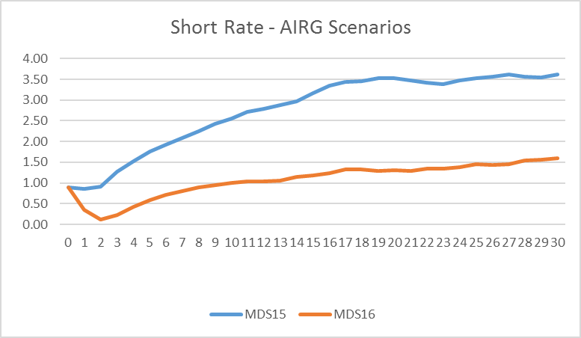

Slide 27
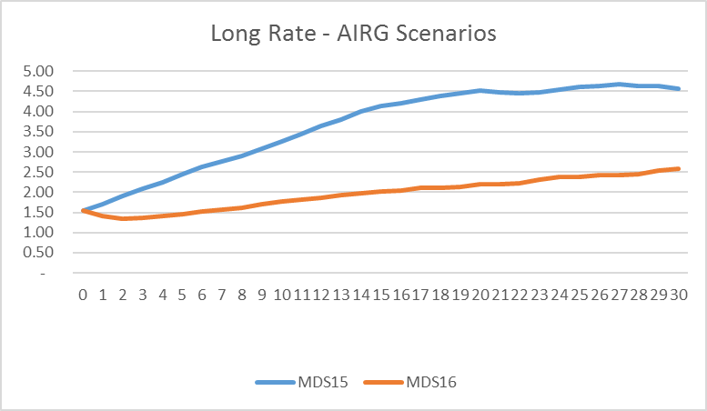

Slide 28
observations
Current interest rate environment
Robustness of scenario sets
Supportability of scenarios
Ability to communicate findings within scenarios
Computing power

Slide 29
Non-interest rate considerations
Common stocks and other equity investments
Corporate bond spreads
Inflation rates

Slide 30
Suggestions for future
Field testing
Economic drivers
More robust scenarios
Analytical rigor/additional judgement
Overlapping data
Federal Reserve impact
Interest rates and fixed income spreads

Slide 31
www.trilogyactuarial.com

